Slide 1
UK BIM Framework

Slide 2
BIM Working Party Strategy Paper (2011)
PUSH (how to make it easier for the supply chain)
Software;
Training; and
Standards.
PULL (how Government would specify)
Specifying information as a delivery requirement; and
Definition of deliverables (standards).
“Government as a client can derive significant improvements in cost, value and carbon performance through the use of open sharable asset information”
Process
Technology
People
Notes:
Key points:
A BEIS (then BIS) facilitated working party came up with the following hypothesis.
Hypothesis considered whole life cost and carbon performance
Strategy had push (how to help) and pull (benchmark to meet)
Standards were seen as key

Slide 3
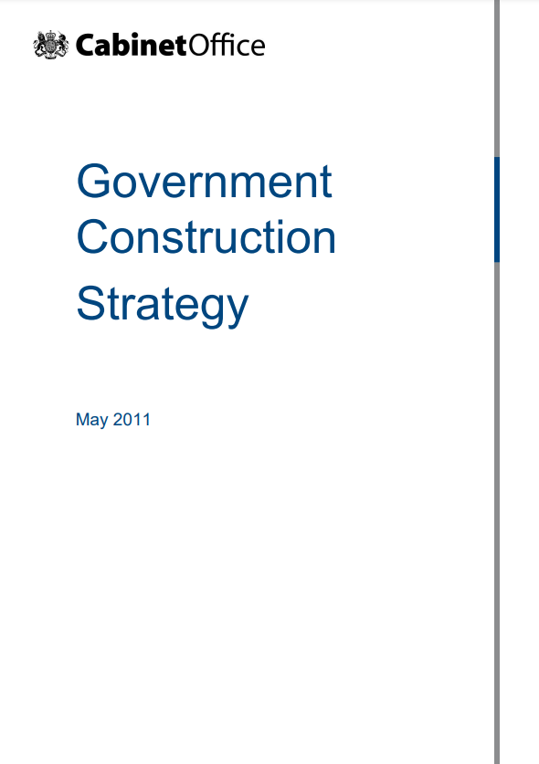
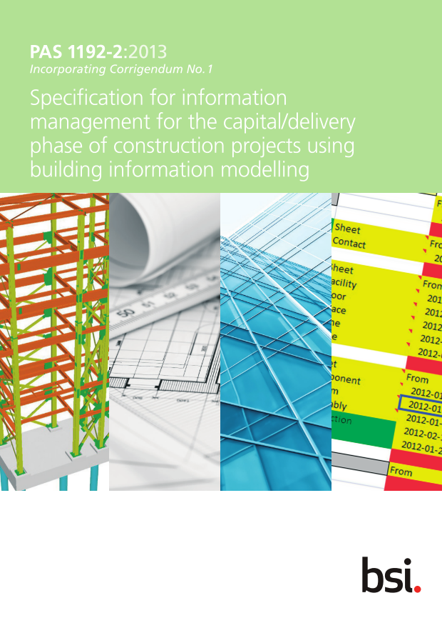
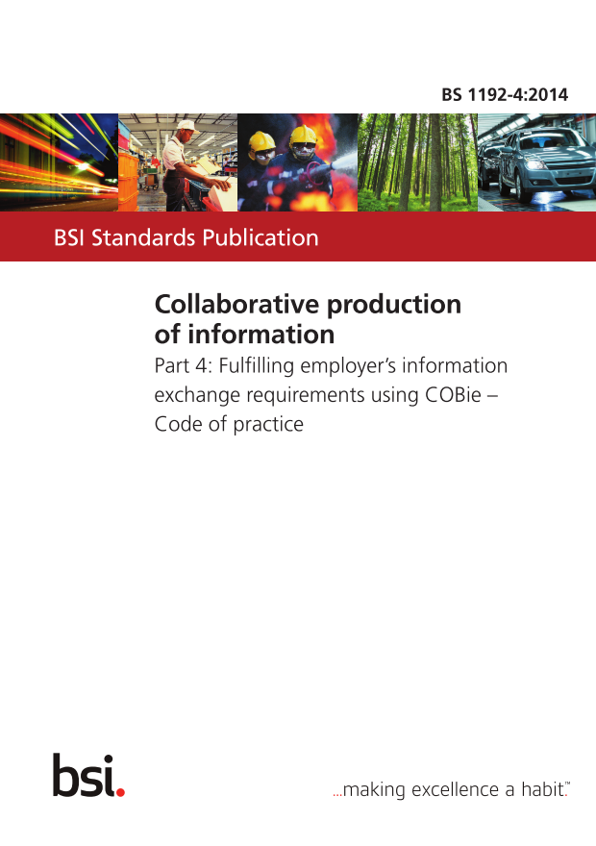
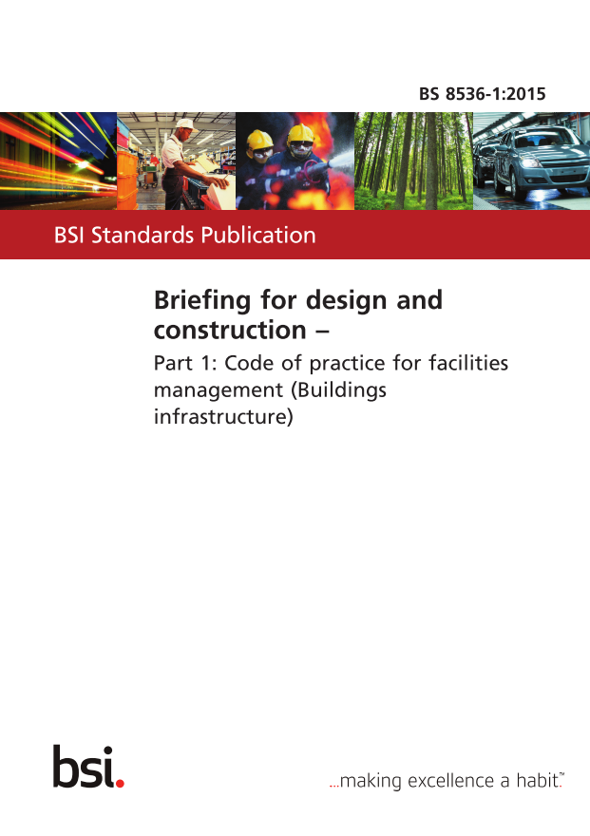
Standards Development (Phase 1)
2.31 The Cabinet Office will co-ordinate Government’s drive to the development of standards enabling all members of the supply chain to work collaboratively through Building Information Modelling (BIM).
2.32 Government will require fully collaborative 3D BIM (with all project and asset information, documentation and data being electronic) as a minimum by 2016.
… | 2011 | 2012 | 2013 | 2014 | 2015 | 2016 | 2017 | 2018 | 2019 | 2020 | 2021 | 2022
To support BS 1192 (Collaborative production):
PAS 1192-2 (Delivery phase);
PAS 1192-3 (Operational phase);
BS 1192-4 (COBie);
PAS 1192-5 (Security-minded); and
BS 8536-1/2 (Operability)
Where developed alongside other resources such as Uniclass and the BIM protocol to support the UK Government Mandate.
Notes:
Key points:
Following the publication of the 2011 Govt. construction strategy document, BSI supported UK Govt. through a coordinated standards development activity.
Notes: This deck intentionally avoids using “BIM Level 2” as the UK is trying to move beyond it. This phase is effectively the BIM Level 2 phase.

Slide 4
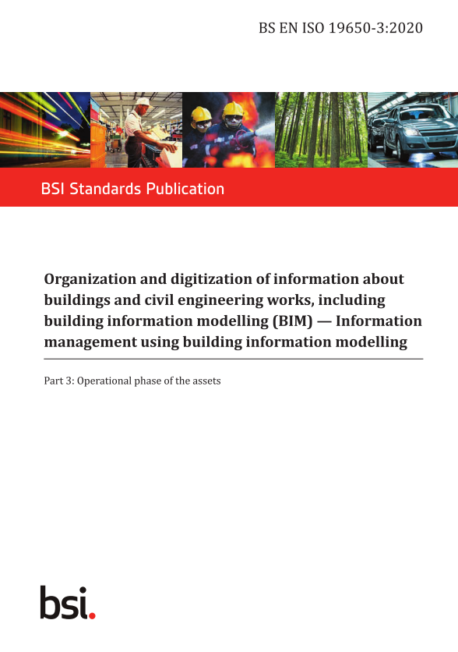
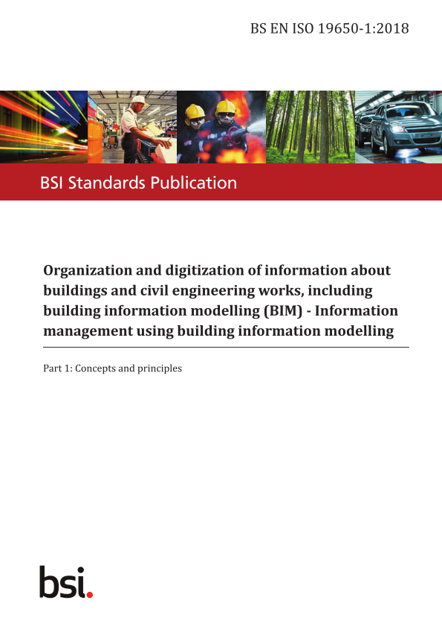
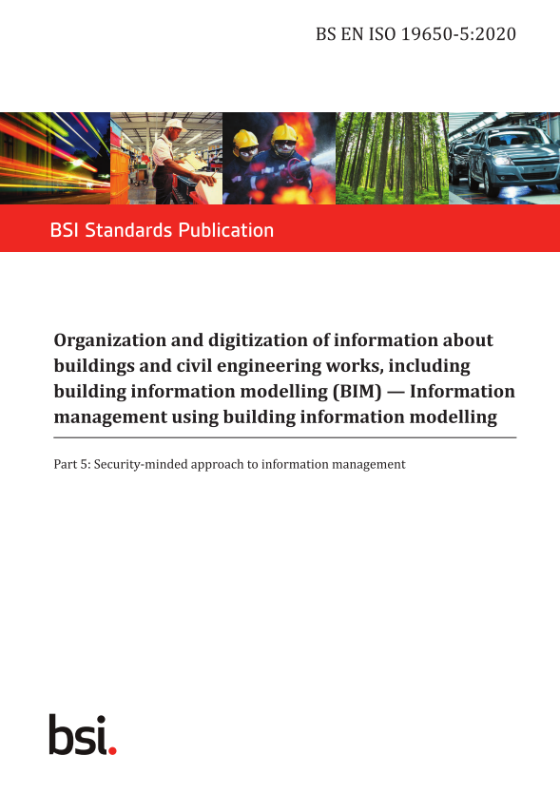
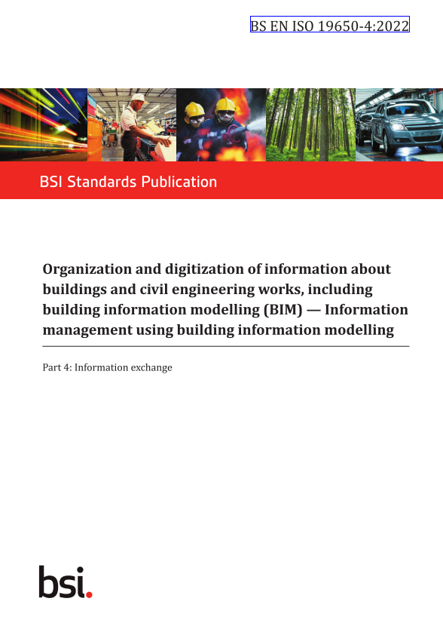
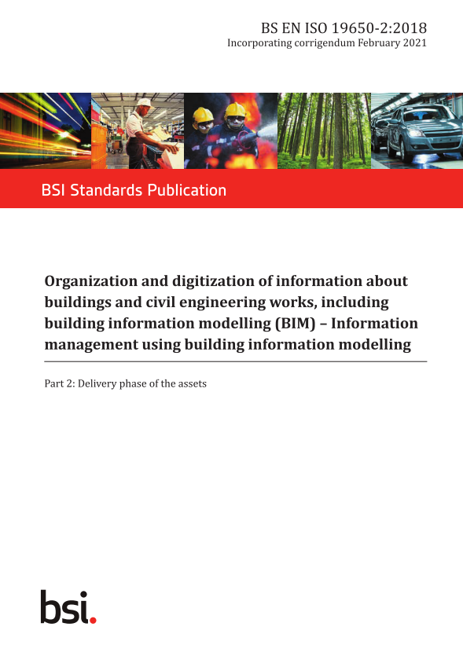
Standards Development (Phase 2)
Following this initial standards development, PAS 1192-6 (health and safety) was also developed.
After garnering international interest, the PAS 1192 series became seed content for the ISO 19650 series; elevating the good practice internationally.
… | 2011 | 2012 | 2013 | 2014 | 2015 | 2016 | 2017 | 2018 | 2019 | 2020 | 2021 | 2022
These standards were then adopted nationally to become:
BS EN ISO 19650-1 (Concepts)
BS EN ISO 19650-2 (Delivery phase)
BS EN ISO 19650-3 (Operational phase)
BS EN ISO 19650-4 (Information exchange)
BS EN ISO 19650-5 (Security-minded)
PAS 1192-6
BS 8536
Notes:
Key points:
Like PAS 55 > ISO 55000 and many others. UK showed leadership that was integrated into international good practice
Notes: This deck intentionally avoids using “BIM Level 2” as the UK is trying to move beyond it. This phase is effectively the transition from “BIM Level 2” to the “UK BIM Framework”

Slide 5
Co-convened by BSI and Nima, the UK BIM Framework is the overarching approach to implementing information management using BIM in the UK, consisting of:
Standards
Guidance
Resources
Source: https://www.ukbimframework.org
Notes:
Key points:
Nima (formally the UK BIM Alliance) co-convene the UK BIM Framework with BSI
Stakeholders like BEIS, IPA, and Construction leadership council sit on its strategy board
Notes: CDBB was a part of this relationship but have since been disbanded.

Slide 6
Three Amigos

Slide 7
National Infrastructure Strategy (2020)
[Built Environment Sector] contributed £117 billion to the UK economy in 2018 and supports over two million jobs, but is one of the nation’s least productive industries, and the built environment is a major contributor to greenhouse gas emissions.
The government can use its weight as a major construction client to transform and modernize the industry.
Signpost to:
Construction Playbook; and
TIP Roadmap to 2030.
Good decision making is underpinned by clear and accessible data – both on the nature of the problems that infrastructure is trying to solve, and on the performance of existing infrastructure systems.
Notes:
Key points:
In 2020, the construction playbook cited the UK BIM Framework, showing UK Govt. continued confidence in the UK approach
In 2021, the TIP roadmap provided an updated mandate
Note: Pink box shows devolved mandates for BIM; making it UK-wide.

Slide 8
The Construction Playbook (2022)
Contracting authorities should use the UK BIM Framework to standardize the approach to generating and classifying data, data security, and data exchange, and to support the adoption of the Information Management Framework and the creation of the National Digital Twin.
as-built project information model delivered to the contracting authority; this should be provided to the standard consistent with the UK BIM Framework
Further embedding digital technologies including the UK BIM Framework and digital twins will improve the performance, sustainability and value for money of projects and programmes.
“Government as a client can derive significant improvements in cost, value and carbon performance through the use of open sharable asset information”
Notes:
Key points:
In 2020, the construction playbook cited the UK BIM Framework, showing UK Govt. continued confidence in the UK approach
In 2021, the TIP roadmap provided an updated mandate
Note: Pink box shows devolved mandates for BIM; making it UK-wide.

Slide 9
Information management mandate (2020)
Information Management Mandate: [Annex B] sets out the information management requirements for government clients that will be delivered through the application of the UK BIM Framework.
[The] Information Management Mandate will be delivered through the application of the UK BIM Framework. Public sector clients should comply with the Mandate as part of their implementation of the Construction Playbook.
Other parts of the UK:
Scotland: SSPN 01/2017: Requiring BIM for projects over £2m;
Northern Ireland: PGN 03/15: Requiring BIM for projects over £4.1m;
Wales: …???
Notes:
Key points:
In 2020, the construction playbook cited the UK BIM Framework, showing UK Govt. continued confidence in the UK approach
In 2021, the TIP roadmap provided an updated mandate
Note: Pink box shows devolved mandates for BIM; making it UK-wide.

Slide 10
Information management mandate
Clients are required to:
Conform to the UK BIM Framework standards;
Follow the sensitivity assessment process (ISO 19650-5);
Have the capability to fulfil the information management function;
Define their information requirements [OIR, AIR, PIR, SIR, and EIR];
Have a digital mechanism to store procured information [CDE];
Specify information requirements within contract documentation; and
Apply the same rigour to the maintenance of information.
Source: https://www.gov.uk/government/publications/transforming-infrastructure-performance-roadmap-to-2030/transforming-infrastructure-performance-roadmap-to-2030#annex-b-information-management-mandate
Notes:
Key points:
The mandate says to follow the standards!

Slide 11
Thank you

